Slide 1
CarRage.io
Team !pip install makeathon
SureStart AI
March 18, 2021
Presented by: Eli Gnesin,
Angela Choi, and Jasmine Le
Notes:
eli

Slide 2
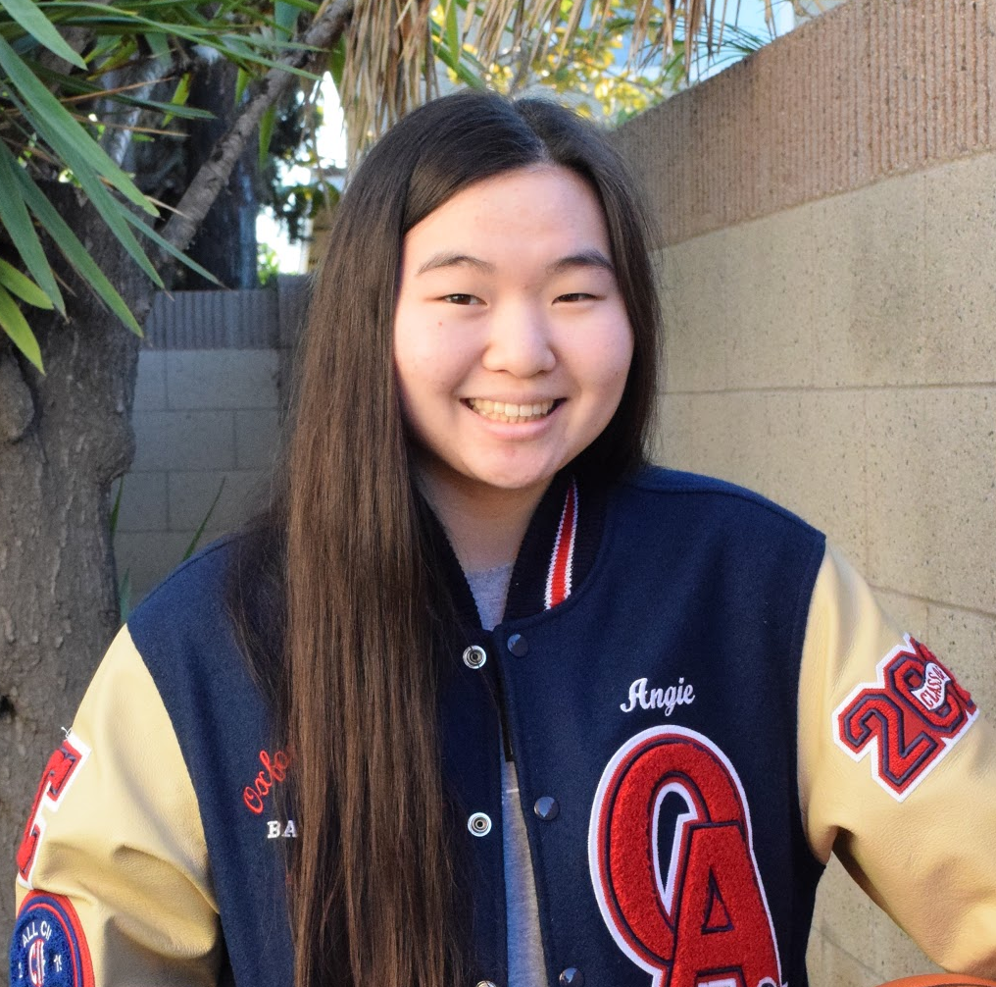
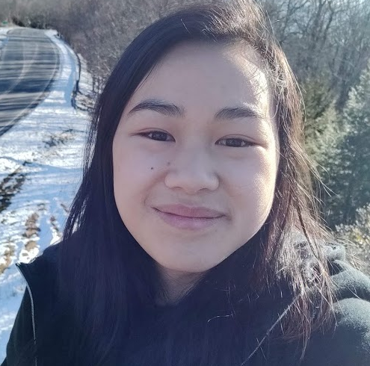
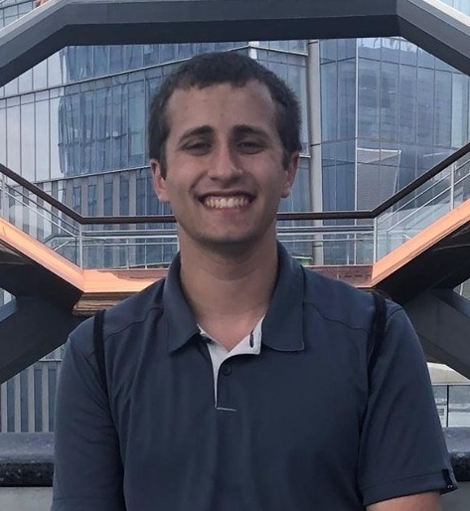
Our Team: !pip install makeathon
Mentor: Sazida Binta Islam
Angela Choi
Jasmine Le
Eli Gnesin
Oxford Academy (HS)
University of Alabama in Huntsville
College of William
and Mary
Notes:
eli

Slide 3
Table of Contents
01
02
03
04
05
06
Problem Statement
Solution
Market Analysis
Why are we doing this project?
How do we solve the problem?
What do other people think about our idea?
Demo
Future Plans
Competitive Analysis
What does our idea look like?
What currently exists that is similar to our idea?
Where do we go next?
Notes:
eli

Slide 4
Road Rage Incidents
VICTIM A
VICTIM B
MARCH 2018
APRIL 2019
“Cops in Minnesota seeking suspect who beat an elderly man in road-rage incident”
“Phoenix Driver Opens Fire on Family's Car, Kills 10-year-old girl”
MINNESOTA
PHOENIX, AZ
Notes:
Jasmine

Slide 5
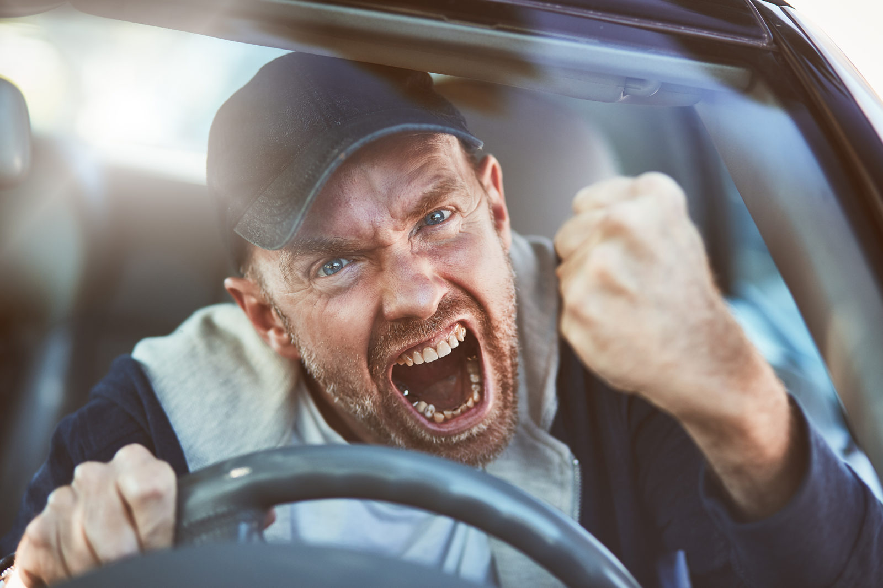
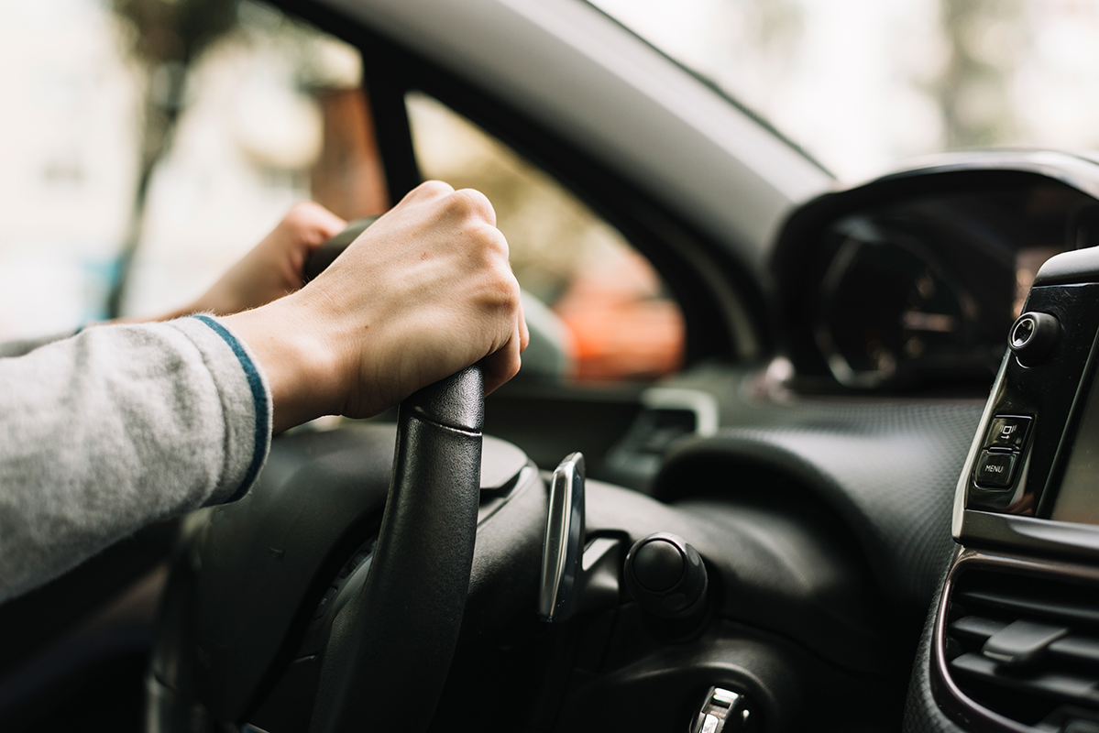
01
Problem Statement
Aggressive Driving is a significant danger to drivers and passengers
136 Road Rage shooting deaths from 2013-2017
How can we detect and prevent road rage before it happens?
https://www.thezebra.com/resources/research/road-rage-statistics/
Notes:
jasmine

Slide 6
02
Solution
Develop software for devices that will:
detect aggression during driving
alert the driver using calming music
record the number of times anger is detected
Notes:
Eli
Say a little about the privacy/ethics concerns here?
Talk more in depth about the code?

Slide 7



Solution Framework
Dataset: FER 2013 Facial Images Dataset from Kaggle
Programming Language: Python (Jupyter Notebook)
Model: Keras, trained on William & Mary HPC
Batch Size: 64
Optimizer: Stochastic Gradient Descent
Epochs: 95 (with Early Stopping)
Loss Function: Categorical Crossentropy
Notes:
eli

Slide 8
Market Research
03
Notes:
Eli -> angela

Slide 9

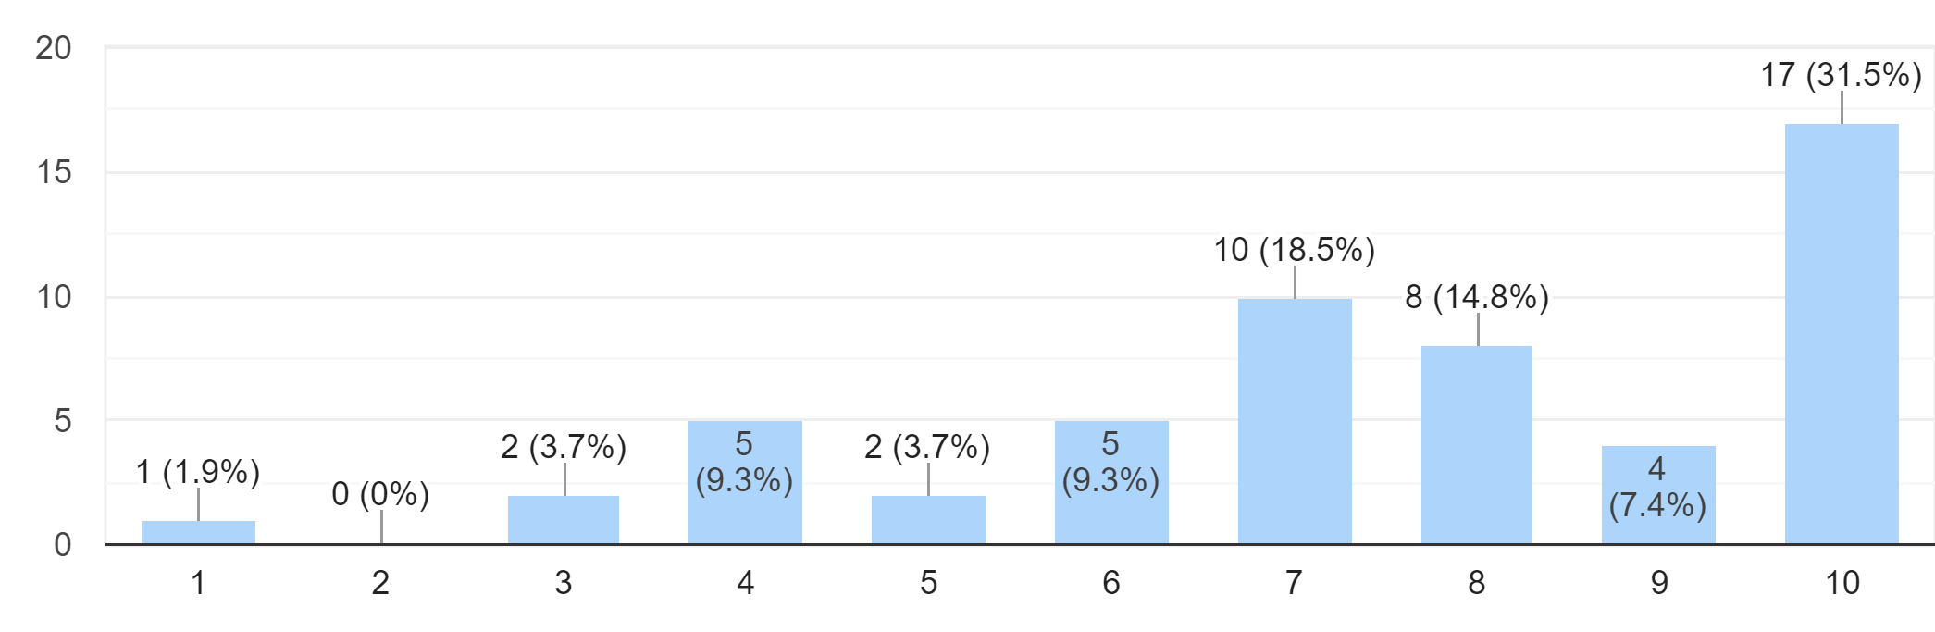
Survey of Potential End-Users
AGE
ROAD RAGE
On a scale from 1 to 10, how serious of a problem do you think aggressive driving/road rage is?
26
22
6
54
6.2 YEARS
7.5 AVG RANKING
Responses
avg. driving experience
Seriousness of road rage
Notes:
angela

Slide 10
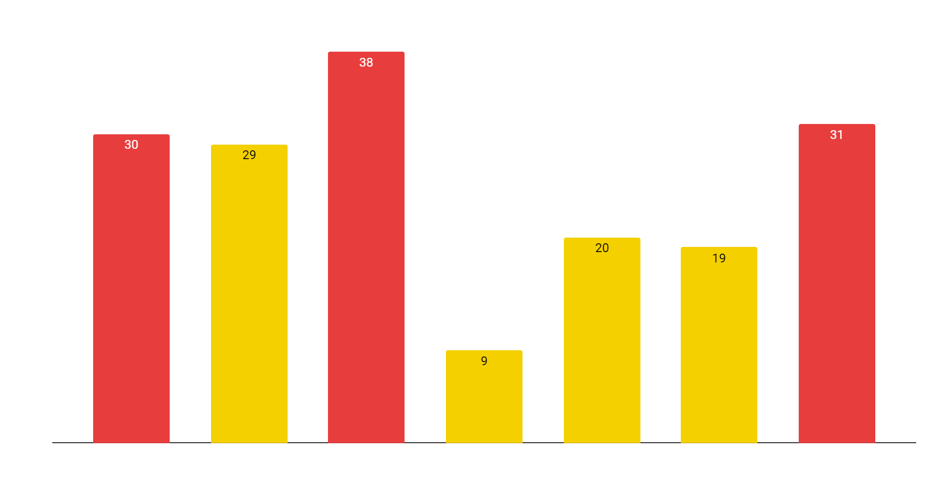
Biggest Stressors while Driving
#1 - Other Drivers (selected by 70.4% of survey takers)
Notes:
angela

Slide 11
End-user Concerns
PRIVACY/ETHICS
MORE FRUSTRATING
DISTRACTION
“I would have concerns regarding privacy… consistent facial monitoring.”
“If people get frustrated enough… this might make them even angrier”
“I would not prefer any distraction, that might cause bigger trouble.”
OUR RESPONSE
OUR RESPONSE
OUR RESPONSE
Inability to transmit information to others
Convince users - net good for them & society
Device feature to turn off alerts during driving
Notes:
angela

Slide 12

04 Demo
Notes:
jasmine

Slide 13
05
Competitor Analysis
ROAD RAGE REMINDER
EPFL IN-CAR EMOTION DETECTOR
UPM MODEL FOR AGGRESSIVE DRIVING
Passive, not active
Detection, not deterrence
Activity, not emotions
Notes:
Jasmine
https://docs.google.com/spreadsheets/d/1zoG_EqzZoZXcNFIqr-fVnog4dF8PROJQ6Euc8ipdS0Q/edit?usp=sharing
EPFL: École polytechnique fédérale de Lausanne OR Swiss Federal Institute of Technology in Lausanne
UPM: Universidad Politécnica de Madrid

Slide 14
06
Future Plan
1
Improve Model
Train a stronger model on larger, more robust dataset
2
Optimize “Calming” Solution
Use consumer testing to find the best solution to calm individuals experiencing anger on the road
3
Expansion
Improve product to include voice detection, heart rate, and gestures, improve summary statistics
Notes:
eli

Slide 15
THANK YOU
Do you have any questions?
Github: https://github.com/Elignesin/Makeathon
Please keep this slide for attribution.
Notes:
eli

